Slide 1
Joint Polar Satellite System (JPSS) Cross-Track Infrared Microwave Sounding Suite (CrIMSS) Environmental Data Record Validation Status
Nicholas R. Nalli,^{1,2} Christopher D. Barnet,¹
Murty Divakarla,^{1,2} Degui Gu,³ Xu Liu,⁵ Susan Kizer,⁵ Lihang Zhou,^{1,4}
Antonia Gambacorta,^{1,6} Mike Wilson,^{1,2} Tony Reale,¹ Dave Tobin,⁷ et al.
¹ NOAA/NESDIS Center for Satellite Applications and Research (STAR), Camp Springs, MD, USA ² I.M. Systems Group, Inc., Rockville, MD, USA
³ Northrop Grumman Aerospace Systems (NGAS), Redondo Beach, CA, USA
⁴ Algorithms and Data Products Program, NOAA/NESDIS/STAR, Silver Spring, MD, USA
⁵NASA Langley Research Center, Hampton, VA, USA
⁶Riverside Technology, Inc., Silver Spring, MD, USA
⁷CIMSS, University of Wisconsin-Madison, Madison, WI, USA
2012 IGARSS Meeting
Munich, Germany
24 July 2012
Notes:
Chris is the CrIMSS EDR Validation and Algorithm Lead

Slide 2
Et al. …
X. Xiong, G. Guo, E. S. Maddy, M. D. Goldberg (NOAA/NESDIS/STAR)
R. Knuteson, H. Revercomb (UW/CIMSS)
E. Joseph, V. Morris (Howard Univ./NCAS)
D. Wolfe (NOAA/ESRL)
A. Mollner (The Aerospace Corporation)
Bill Blackwell (MIT Lincoln Laboratory)
B. Sun, F. Tilley, M. Pettey (NOAA/NESDIS/STAR NPROVS developers)
L. Strow (UMBC)
J. Susskind (NASA/GSFC)

Slide 3
Outline
CrIMSS (CrIS/ATMS) EDR Product Overview
AVTP, AVMP (KPPs), AVPP, O₃ (IP)
EDR Cal/Val Program
Overview
Intensive Cal/Val (ICV) Status Highlights
3
Notes:
CrIMSS – Cross-track Infrared Microwave Sounding Suite
CrIS – Cross-track Infrared Sounder
ATMS – Advanced Technology Microwave Sounder

Slide 4
Product OVERVIEW
CrIMSS EDR

Slide 5
Atmospheric Vertical Temperature, Moisture and Pressure Profile (AVTP, AVMP, AVPP) Environmental Data Records (EDRs)
CrIMSS AVTP EDR (Offline) – Focus Day (15 May 2012)
AVTP, AVMP, AVPP are Key Performance Parameters (KPPs) for lower troposphere
Used for initialization of NWP models, forecasting / nowcasting weather, severe weather, cloud info and winds, basic science, etc.
NGAS Algorithm: Optimal Estimation (OE) method, no front-end regression
AVTP, AVMP, AVPP, O₃-IP, surface skin temperature and emissivity retrieved simultaneously
Non-precipitating scenes
Code implementations
IDPS operational product (42/22 layer)
“Offline EDR” (NASA/LaRC and STAR) used for testing, validation, optimization (100 layer)
NGAS science code (100 layer)
NOAA Unique CrIS/ATMS Processing System (NUCAPS): AIRS approach, multi-step iterative method, front-end regression
Operational product in Feb 2013
CrIMSS AVMP EDR (Offline) – Focus Day (15 May 2012)
Notes:
IDPS – Interface Data Processing Segment
The CrIMSS operational algorithm is an optimal estimation (OE) approach with minimization achieved using with a modified (linearized, instead of 2nd derivative) Levenbrg-Marquart (1940s): obs − calc residual high = more damping; no regression front-end. NGAS is “more theoretically sound” but never been tested.
CrIMSS LaRC v1.5 implementation of NGAS algorithm is run offline at STAR and LaRC (current version larc_crimss_v1.5.05.00_20120515xu)
The Soumi NPP CrIMSS EDRs are at FOR = 3x3 FOVs (40km) resolution.
The horizontal cell size (HCS) for the JPSS CrIMSS EDRs was designed for:
1. 1x1 (single) FOV (14km at nadir) for “clear” conditions
2. 2x2 FOVs (28km at nadir) for partly “cloudy” conditions
3. 3x3 FOVs (40km) for cloudy “conditions.”

Slide 6
JPSS Specification Performance Requirements
Atmospheric Vertical Temperature Profile (AVTP) Measurement Uncertainty – Layer Average Temperature Error
PARAMETER | THRESHOLD
AVTP Clear, surface to 300 mb | 1.6 K / 1-km layer
AVTP Clear, 300 to 30 mb | 1.5 K / 3-km layer
AVTP Clear, 30 mb to 1 mb | 1.5 K / 5-km layer
AVTP Clear, 1 mb to 0.5 mb | 3.5 K / 5-km layer
AVTP Cloudy , surface to 700 mb | 2.5 K / 1-km layer
AVTP Cloudy, 700 mb to 300 mb | 1.5 K / 1-km layer
AVTP Cloudy, 300 mb to 30 mb | 1.5 K / 3-km layer
AVTP Cloudy, 30 mb to 1 mb | 1.5 K / 5-km layer
AVTP Cloudy, 1 mb to 0.5 mb | 3.5 K/ 5-km layer
Bold = KPP
Atmospheric Vertical Moisture Profile (AVMP) Measurement Uncertainty – 2-km Layer Average Mixing Ratio % Error
PARAMETER | THRESHOLD
AVMP Clear, surface to 600 mb | Greater of 20% or 0.2 g/kg / 2-km layer
AVMP Clear, 600 to 300 mb | Greater of 35% or 0.1 g/kg / 2-km layer
AVMP Clear, 300 to 100 mb | Greater of 35% or 0.1 g/kg / 2-km layer
AVMP Cloudy, surface to 600 mb | Greater of 20% of 0.2 g/kg / 2-km layer
AVMP Cloudy, 600 mb to 400 mb | Greater of 40% or 0.1 g/kg / 2-km layer
AVMP Cloudy, 400 mb to 100 mb | Greater of 40% or 0.1 g/kg / 2-km layer
Notes:
KPPs in boldface
Old NPOESS Requirements:
IORD – Integrated Operational Requirements Document
NGAS – Northrop Grumman Aerospace Systems
“Partly Cloudy” – ≤50% cloudiness
“Cloudy” – >50% cloudiness
Clear – the CrIMSS EDR retrieval algorithm detected no cloud within a FOR;
Cloudy – the CrIMSS EDR algorithm detected overcast cloud or more than three layers of clouds within a FOR;
Partly Cloudy – the CrIMSS algorithm detected one to three layers of clouds.

Slide 7
Cal/val PROGRAM: overview
CrIMSS EDR

Slide 8
CrIMSS Cal/Val Overview
NPP CrIMSS EDR Cal/Val Plan: Ensure the EDR products comply with the requirements of the sponsoring agencies and have met global performance specifications.
Incorporated the NGAS and former IPO plans
Draws on validation experience from AIRS/AMSU and IASI/AMSU/MHS.
Leverage Team of Subject Matter Experts (SME) for heritage knowledge, experience
Leverage existing capabilities
Use proven datasets for global validation (ECMWF, NCEP/GFS, RAOBs, etc)
Assess against heritage sensors and algorithms
NUCAPS
AIRS and IASI processing and validation systems
ATOVS (HIRS/AMSU) legacy products to demonstrate the value of hyperspectral
Tool: NOAA Products Validation System (NPROVS) (Reale et al. 2012)
Intensive field campaign cal/val experience
Roll-up ensemble assessments to evaluate that EDRs have met global spec
Validation methods characterize the performance of the EDRs in various ensembles
Stratify specs according to various bins
day/night and latitude bands (i.e., polar, midlatitude, tropical)
land/ocean/ regional, altitude, surface characteristics
8
Notes:
IDPS – Interface Data Processing Segment

Slide 9
Team Members – Roles & Responsibilities
Cal/Val | Name | Organization | Funding Agency | Task
NOAA Team Members
Lead | Chris Barnet | NOAA/NESDIS/STAR | NJO | Lead CrIMSS EDR Team
AVTP/AVMP | Changyong Cao | NOAA/NESDIS/STAR | NJO | Coordination w/ GSICS
AVTP/AVMP | Mitch Goldberg | JPSS | NJO & NOAA-PSDI | JPSS Program Scientist
AVTP/AVMP | Anthony Reale | NOAA/NESDIS/STAR | NJO | NPROVS
AVTP/AVMP | Fuzhong Weng | NOAA/NESDIS/STAR | NOAA-PSDI | MiRS
CrIS SDR | Yong Han | NOAA/NESDIS/STAR | NJO | Lead CrIS SDR
ATMS SDR | Tsan Mo | NOAA/NESDIS/STAR | NJO | Lead ATMS SDR
NOAA-External Team Members
AVTP/AVMP | Bill Blackwell | MIT | NJO | Microwave products
AVTP/AVMP | Allan Larar | NASA/LaRC | NJO | EDR Validation
AVTP/AVMP | Xu Liu | NASA/LaRC | NJO | IASI proxy, EDR validation
AVTP/AVMP | Hank Revercomb | SSEC | NJO | SDR, PEATE
AVTP/AVMP | Dave Tobin | SSEC | NJO | ARM-RAOBS
AVTP/AVMP | Larrabee Strow | UMBC | NJO | OSS validation
AVTP/AVMP | Joel Susskind | NASA/GSFC | NJO | AIRS proxy
CrIMSS SDR | Steven Beck | Aerospace Corp. | external | RAOB, LIDAR
CrIMSS SDR | Steven English | UKMET | external | UKMET analysis
CrIMSS SDR | William Bell | ECMWF | external | ECMWF analysis
AVTP/AVMP | Steve Friedman | NASA/JPL | NASA | Sounder PEATE
AVTP/AVMP CrIS SDR | Denise Hagan Degui Gu | NGAS | NG Prime | EDR Validation / SDR coordination
9
Notes:
NJO – NOAA JPSS Office

Slide 10
Cal/Val Plan Phases
Pre-Launch
Demonstrate launch-readiness
Concluded 
Early Orbit Checkout (EOC)
L + 90 days, as sensors are activated
Concluded 
Intensive Cal/Val (ICV)
Stable SDR out to L + 24 months
Validation of EDRs against multiple correlative datasets
Underway
Long-Term Monitoring (LTM)
From end of ICV (L + 24 months) to the end of operational lifetime
Characterization of all EDR products and long-term demonstration of performance
10

Slide 11
EDR Validation Hierarchy: ICV–LTM Phases
Model comparisons (e.g., ECMWF and NCEP/GFS)
Satellite EDR intercomparisons (e.g., NUCAPS, AIRS/IASI, ATOVS, COSMIC)
Operational RAOBs
Useful for global zonal representation and long-term characterization.
Statistical significance after couple months’ accumulation.
Dedicated RAOBs
Detailed performance specification; regional characterization
ARM sites; sites of opportunity; ideally GCOS Reference Upper Air Network (GRUAN)
Intensive Field Campaigns (e.g., Tobin et al. 2006, Nalli et al. 2006, JGR, 111; Taylor et al. 2008, BAMS, 89; Blackwell et al. 2001, TGARS, 39)
Dedicated RAOBs
Ideally project-coordinated aircraft campaign using NAST-I, -M and/or S-HIS
Coordinate/leverage with other missions (e.g., HS3)
Scientific campaigns of opportunity
Low cost, low risk; synergism; engages science community
NOAA Aerosols and Ocean Science Expeditions (AEROSE) (Nalli et al. 2011, BAMS, 92(6))
Advantages
Can provide independent correlative data not assimilated into NWP models
Detailed performance specification; state specification; SDR cal/val; regional characterization
11
Notes:
ICV up to 18 months
GCOS – Global Climate Observing System

Slide 12
NPP EDR Product Maturity Levels

Slide 13
Cal/val PROGRAM: ICV STATUS highlights
CrIMSS EDR

Slide 14
ICV Activities
Suomi NPP EDR Cal/Val Milestones
Date | Milestone
28 Oct 2011 | Suomi NPP Launch
08 Nov 2011 | ATMS First Light
17 Nov 2011 | NPP reaches mission orbit
21 Nov 2011 | VIIRS First Light
Dec 2011 – Jan 2012 | ATMS Tuning
18 Jan 2012 | CrIS First Light
Feb 2012 | Beta ATMS SDR
Feb–Jun 2012 | CrIS Tuning
Apr 2012 | Beta CrIS SDR
Apr–May 2012 | Segue into ICV phase
31 Jul 2012 | Beta Maturity EDR Validation Report
Nov 2012 | Provisional Maturity EDR
Apr 2013 | Stage 1 Validated EDR
Beta maturity evaluation
Global assessments obtained using matched ECMWF fields
Focus Days
4 planned per year
1st : 11 Nov 2011; 2nd: 24-26 Feb 2012
3rd: 15 May 2012
CrIS/ATMS SDR at beta maturity
Good overlap with Aqua, SNOs
See poster MOP.P.8 (Divakarla et al.)
Global operational RAOB-NPP matchups are being accumulated for a statistical in situ sample
Dedicated RAOBs are being coordinated at several representative sites
Request made for EDR beta maturity
Suomi NPP CrIMSS EDR Maturity
Algorithm | Beta | Provisional | Val 1 | Val 2 | Val 3
AVTP AVMP AVPP | L + 9m Jul 2012 | L + 12m Oct 2012 | L + 18m Apr 2013 | L + 24m Oct 2013 | L + 36m Oct 2014

Slide 15
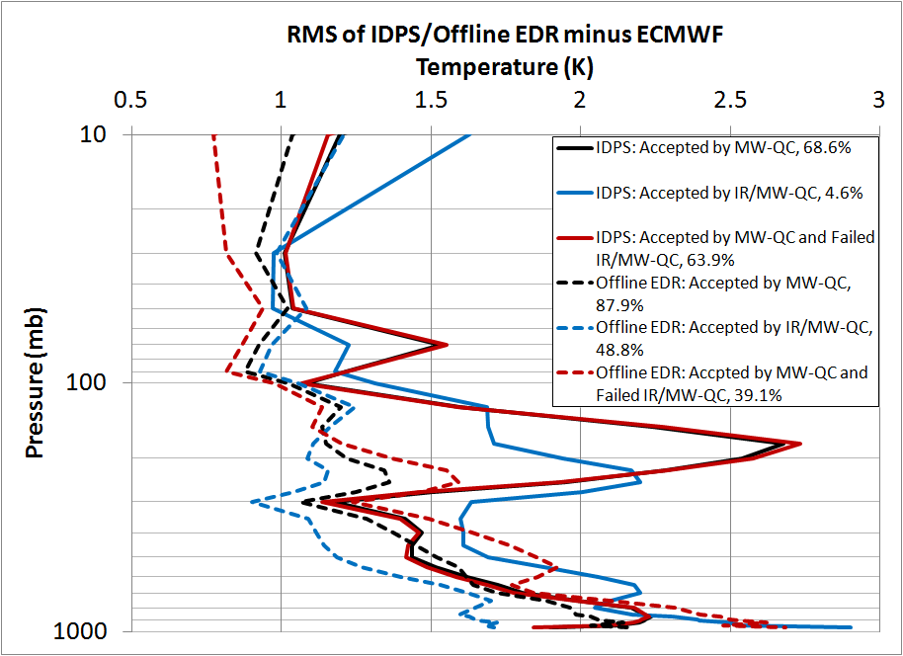
Beta Maturity Evaluation AVTP Versus ECMWF (15-May-12 Focus Day, n = 2318)
IDPS yield is low, and performance suboptimal, due to use of prelaunch LUT noise estimates, MW/IR radiance bias corrections, and emissivity climatology.
MW-only yield (red lines) is 63.9%, IR+MW yield (blue) is 4.6%.
Offline code with optimization (not implemented in IDPS at this time) improves both yield (39.2% MW+IR 48.9%) and performance (dashed lines).
Notes:
The temperature graphs are run on a set of 2318 granules. Those are May 15th granules that have ECMWF, AVN, IDPS, and the offline EDR all available. (about 300 granules were missing one of those four) The water vapor graphs are run on 2313 granules. (5 of the 2318 did not generate water vapor results for whatever reason.) The lines on the graph are as follows: Solid lines are the IDPS result. Dashed lines are the offline EDR. Black is all profiles that pass the MW-only part of the run. Black is then split into Red and Blue. Red is all of the black runs that fail the combined run. Blue is all of the black runs that pass the combined run.
bias (temperature): mean(ret-ecm) rms (temperature): sqrt[mean((ret-ecm)^{^2})] std dev (temperature): sdv(ret-ecm) bias (H2O): 100*mean(ret-ecm)/mean(ecm) rms (H2O): 100*sqrt[mean((ret-ecm)^{^2})]/sqrt[mean(ecm^{^2})] %sdv = sqrt{ %rms^{^2} - %bias^{^2} }
IDPS – Interface Data Processing Segment

Slide 16
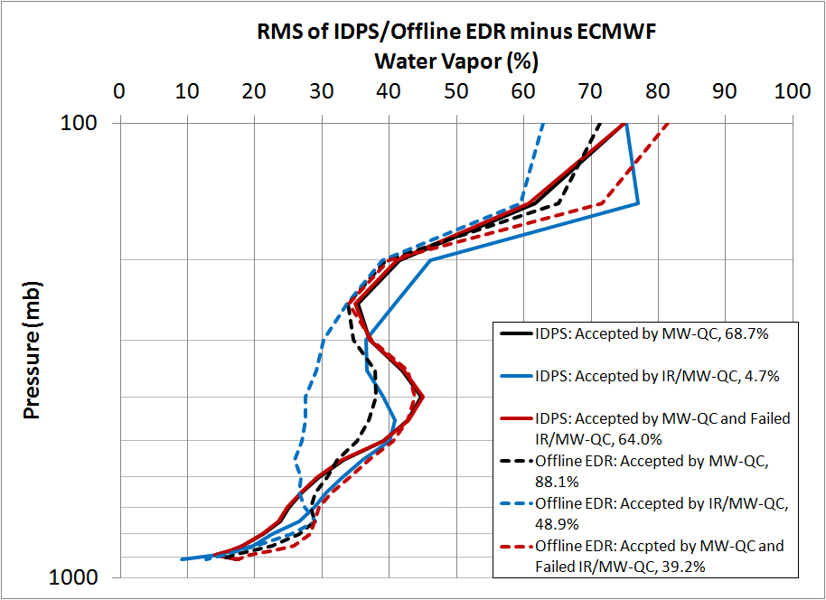
Beta Maturity Evaluation AVMP Versus ECMWF (15-May-12 Focus Day, n = 2313)
IDPS yield is low, and performance suboptimal, due to use of prelaunch LUT noise estimates, MW/IR radiance bias corrections, and emissivity climatology.
MW-only yield (red lines) is 64.0%, IR+MW yield (blue) is 4.7%.
Offline code with optimization (not implemented in IDPS at this time) improves both yield (39.2% MW+IR 48.9%) and performance (dashed lines).
Notes:
The temperature graphs are run on a set of 2318 granules. Those are May 15th granules that have ECMWF, AVN, IDPS, and the offline EDR all available. (about 300 granules were missing one of those four) The water vapor graphs are run on 2313 granules. (5 of the 2318 did not generate water vapor results for whatever reason.) The lines on the graph are as follows: Solid lines are the IDPS result. Dashed lines are the offline EDR. Black is all profiles that pass the MW-only part of the run. Black is then split into Red and Blue. Red is all of the black runs that fail the combined run. Blue is all of the black runs that pass the combined run.
bias (temperature): mean(ret-ecm) rms (temperature): sqrt[mean((ret-ecm)^{^2})] std dev (temperature): sdv(ret-ecm) bias (H2O): 100*mean(ret-ecm)/mean(ecm) rms (H2O): 100*sqrt[mean((ret-ecm)^{^2})]/sqrt[mean(ecm^{^2})] %sdv = sqrt{ %rms^{^2} - %bias^{^2} }
IDPS – Interface Data Processing Segment

Slide 17
NUCAPS / AIRS v5.9 Comparison
15 May 2012 Focus Day
Red = NUCAPS (vs. ECMWF)
Blue = AIRS v5.9 (vs. ECMWF)
Divided according to tropical, midlatitude and polar zones
NUCAPS EDRs are comparable to AIRS, but not fully optimized

Slide 18
ICV 2012 Coordinated Dedicated RAOB Campaign
ARM Sites (n = 450)
Tropical Western Pacific (TWP, island) (90)
Southern Great Plains (SGP) (180)
North Slope Alaska (NSA) (180)
Jul–Sep 2012
JPSS funded
Kauai, Hawaii (PMRF) Site (n = 20+)
Tropical Central Pacific (island)
May 2012 (20), Sep 2012 (?)
Collocated lidar
Collaborator: The Aerospace Corp.
Beltsville, MD (BCCSO) Site (n = 10+)
Urban midlatitude
Jun–Sep 2012
Collaborator: HU/NCAS
NOAA AEROSE Cruise (n ≈ 60)
Tropical Atlantic (ship)
September 2012
Possible HS3 Campaign AC overflight
JPSS funded
Collaborators: HU/NCAS, NOAA/ESRL
Notes:
BCCSO – Beltsville Center for Climate System Operation
PMRF – Pacific Missile Range Facility

Slide 19
Beta Maturity Evaluation Dedicated RAOB* (15-May-12 Focus Day)
*1 of 20 dedicated RAOBs launched by The Aerospace Corp from Kauai, Hawaii in May 2012.

Slide 20
Summary
The status of the Suomi NPP CrIMSS EDR Cal/Val Program for atmospheric sounding EDRs was overviewed in this presentation. The validation program is to ensure the data products comply with the requirements of the sponsoring agencies (i.e., meet spec).
Intensive Cal/Val (ICV) efforts are currently underway
Beta EDR maturity evaluation
Global assessments obtained using matched ECMWF fields
Offline AVTP product performance is close to meeting spec at this time
For more details, see poster MOP.P.8 (Divakarla et al.)
Request for beta maturity has been made
Provisional EDR maturity evaluation
Global RAOB matchups are being acquired for statistical global ensemble
Dedicated RAOB campaign has been coordinated for 2012 leveraging collaborators to attain several launch sites, including tropical open ocean, midlatitude land, urban, and polar regions

